Slide 1
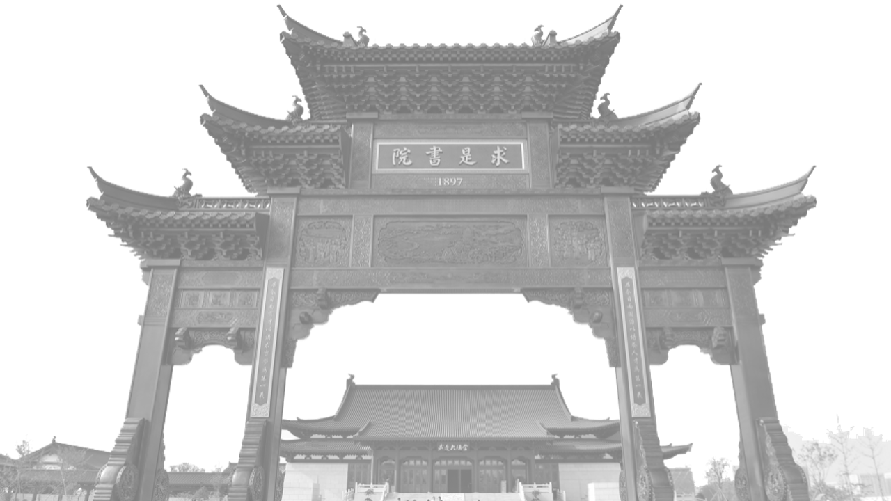
Reproduction of paper <Rough sketch simplification –SimoSerra et al.>
小组成员：王海纳（答辩人）、卜一轩
Notes:
使用说明：
1、这里是1#封面；

Slide 2
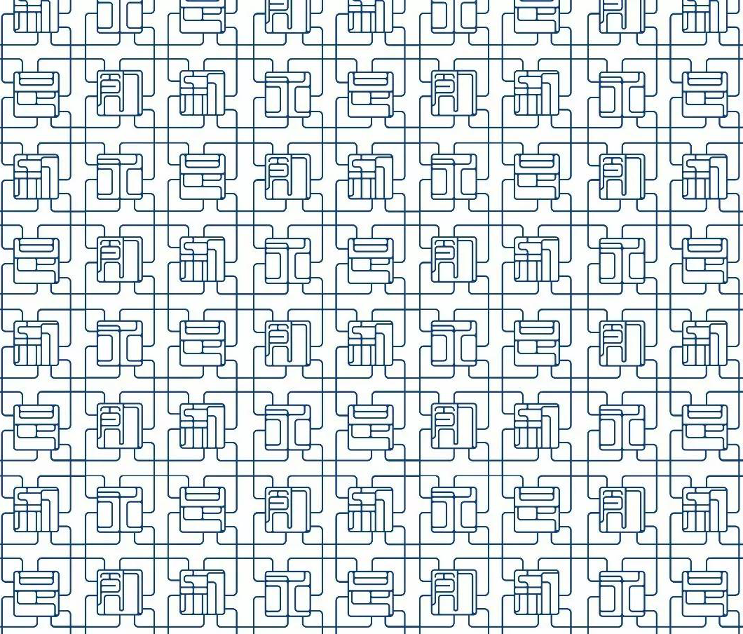

00 Overview
CONTENTS
01 Paper Reviews
02 Reproductions
03 Analysis
04 Discussion
Notes:
使用说明：
1、这里是1#目录页

Slide 3
00
Overview
Overview of our presentation
Notes:
使用说明：
1、这里是1#转场页，图片为紫金港西区求是书院建筑群

Slide 4
00 Overview (1/3)
We’ve reproduced the paper “Rough sketch simplification” by Edgar Simo-Serra Et al, published in SIGGRAPH 2016.
Our work includes:
Rewrite the author’s .lua code into python, and reproduce every figures in the paper with our own data, comparing them with original figures and make analysis & discussions.
Design some tests to validate the main contribution of the paper.
Make further discussions about paper from today’s aspect.
Notes:
使用说明：
1、这里是二段式文字页
2、文本框可自由填入内容，如文字过多，会自动缩排

Slide 5
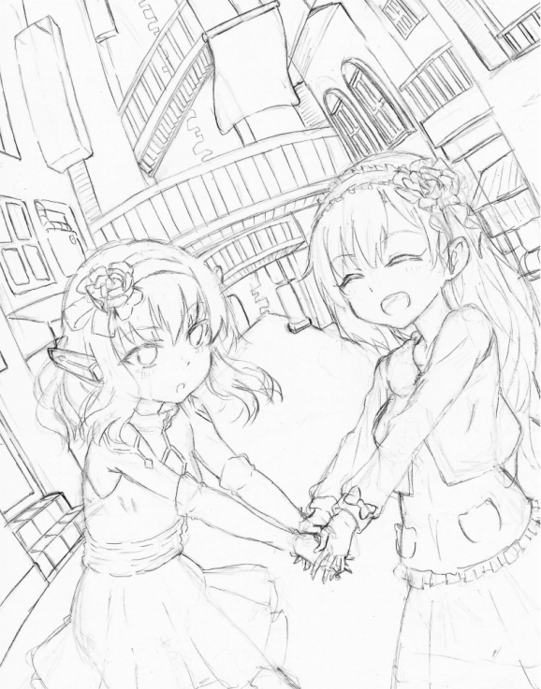
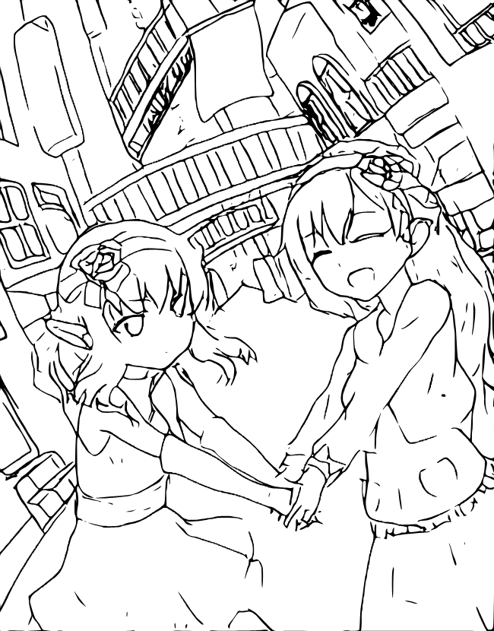
00 Overview (2/3)
Source
Ours-after
Notes:
使用说明：
1、这里是二段式文字页
2、文本框可自由填入内容，如文字过多，会自动缩排

Slide 6
00 Overview (3/3)
References to author’s work
Contents | Author | Our action
Training Code | Provided in Lua.torch on Github Other’s provided modified pytorch code. | Rewrite it in Pytorch(torch==2.0.1, torchvision==0.15.2)
Dataset & Data construction code | Not provided | Prepared from various sources and construct data by ourselves
Further treatments’ Code | Not provided | explored by ourselves
Notes:
使用说明：
1、这里是二段式文字页
2、文本框可自由填入内容，如文字过多，会自动缩排

Slide 7
01
Paper review
Review of the original paper.
(All pictures in this sections are from the original paper if non mentioned)
Notes:
使用说明：
1、这里是1#转场页，图片为紫金港西区求是书院建筑群

Slide 8
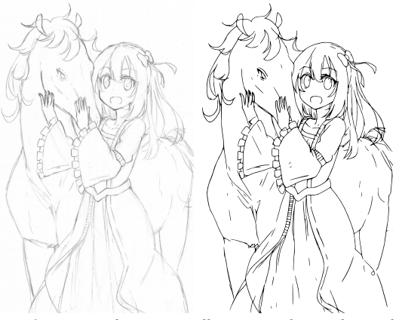
01 Paper Reviews(1/8)
The overall contribution of this paper:
1)The first sketch simplification approach that is optimized to directly operate on raster images of rough sketches.
2)A novel fully Convolutional Neural Network architecture that can simplify sketches directly from images of any resolution.
3)An efficient approach to learn the sketch simplification network.
4)A dataset for large-scale learning of sketch simplification. (Not provided)
Notes:
使用说明：
1、这里是另一种文字页
2、文本框可自由填入内容，如文字过多，会自动缩排

Slide 9
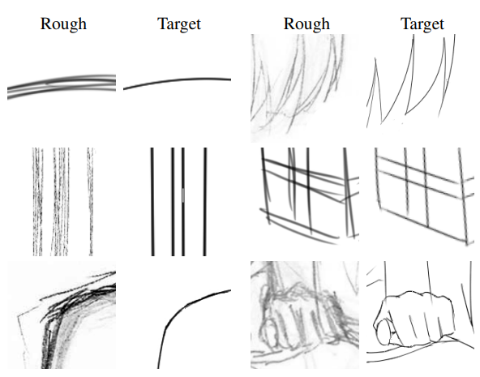
01 Paper Reviews(2/8)
Examples of anime sketch simplifications.
It’s quite common for multiple lines to have to be collapsed into a single line.
The intensity of different input lines vary greatly even within the same image.
Notes:
使用说明：
1、这里是另一种文字页
2、文本框可自由填入内容，如文字过多，会自动缩排

Slide 10
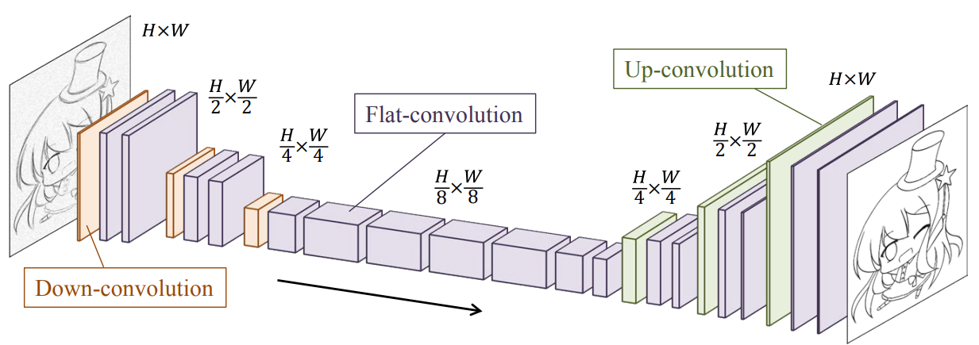
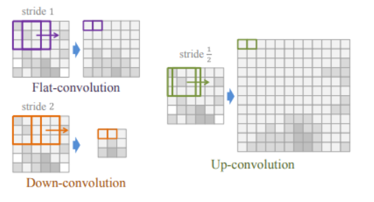
01 Paper Reviews(3/8)
Overview of the convolutional network structure. (U-net like)
The novel points(at 2016) the author argues:
Accumulated 8*8 pixel pooling in form of down-convolutions, which enables larger range of output image resolution.
Notes:
使用说明：
1、这里是另一种文字页
2、文本框可自由填入内容，如文字过多，会自动缩排

Slide 11
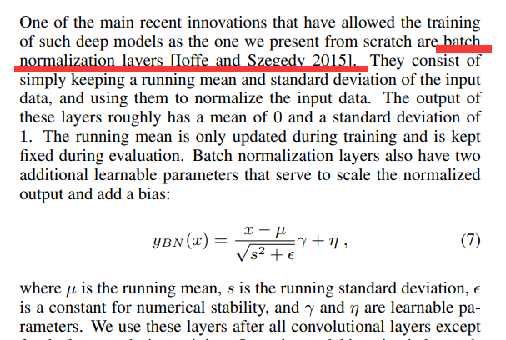
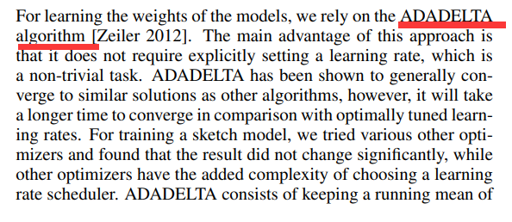
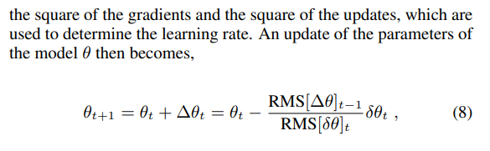
01 Paper Reviews(4/8)
Besides convolutions, the author stresses batch normalization and uses ADADELTA as the learning method.
However these are just common methods in pytorch now…
Notes:
使用说明：
1、这里是另一种文字页
2、文本框可自由填入内容，如文字过多，会自动缩排

Slide 12
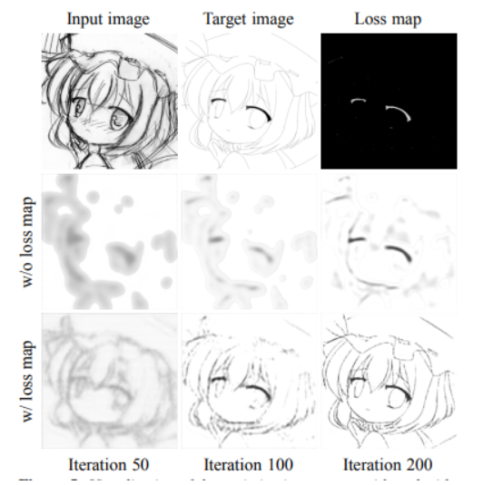
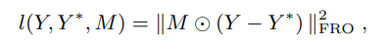
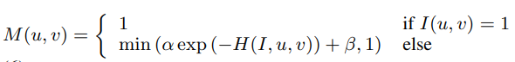
01 Paper Reviews(5/8)
The author use the folloing loss map to calculate the loss function.
Y is current image, Y* is ground truth, I(u,v) denotes a pixel on Y.
H(I,u,v) is the “value of the bin of the local normalized histogram constructed using all pixels within Dh pixels from center using Bh bins in which I(u,v) falls into”. This will be discussed Further.
Notes:
使用说明：
1、这里是另一种文字页
2、文本框可自由填入内容，如文字过多，会自动缩排

Slide 13
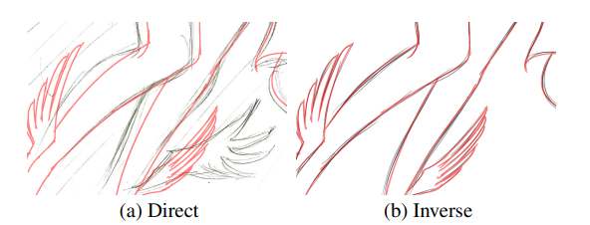
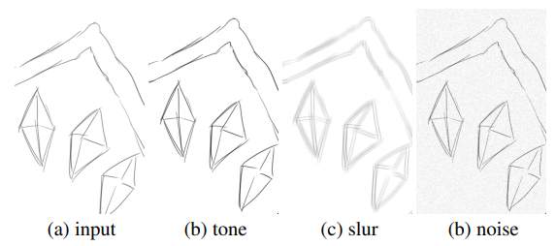
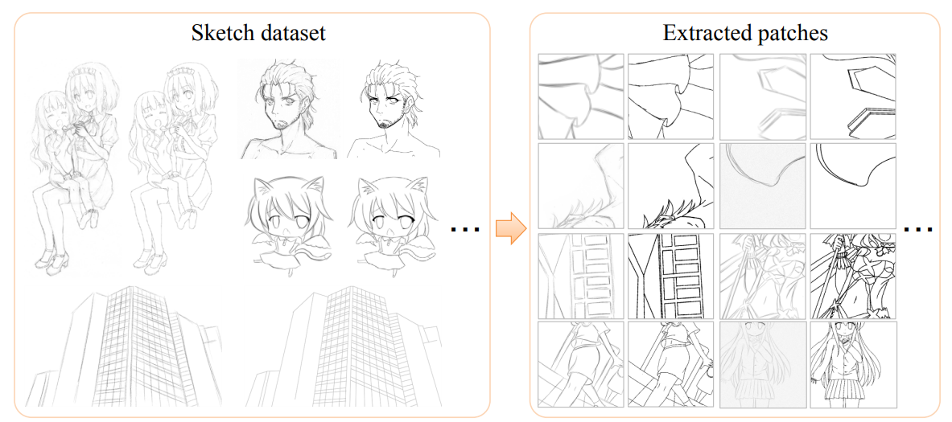
01 Paper Reviews(6/8)
The author’s team use a special method to design and use the dataset:
Inverse dataset generation
Instead of asking artists to draw rough sketch and clean it up, the author only ask for clean sketch and use tools like Adobe Photoshop to add noises manually.
After this, they randomly pick a fixed-size patches from every picture to use for training.
Notes:
使用说明：
1、这里是另一种文字页
2、文本框可自由填入内容，如文字过多，会自动缩排

Slide 14
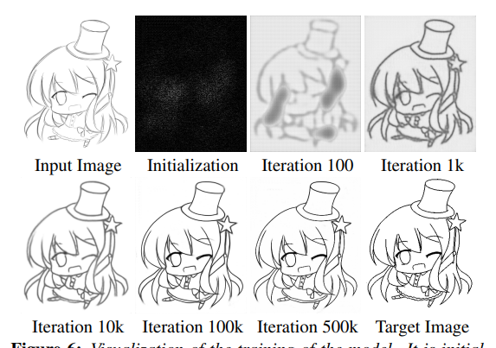
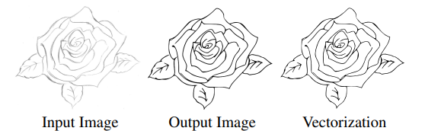
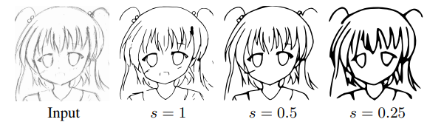
01 Paper Reviews(7/8)
The training results with different number of iterations.
The author further attempted Vectorization using “automatic publically available tools with default parameters”
The author also argue that the extend of simplification can be controlled by scaling the pictures.
Notes:
使用说明：
1、这里是另一种文字页
2、文本框可自由填入内容，如文字过多，会自动缩排

Slide 15
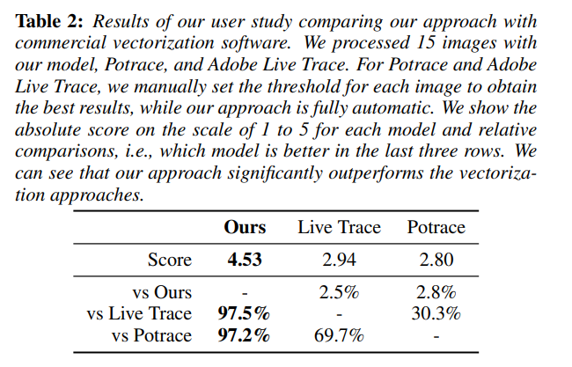
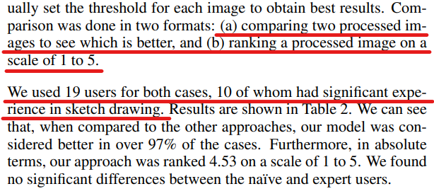
01 Paper Reviews(8/8)
Obviously objective scores cannot evaluate the result well.
So the author designed questionnaires whose question includes “rate from 1-5” and “which one is better among the 3”.
The questionnaires are delivered to 19 users, among which 10 are experts.
The score of their method seemed quite competitive, and did not vary between experts and amateurs.
Notes:
使用说明：
1、这里是另一种文字页
2、文本框可自由填入内容，如文字过多，会自动缩排

Slide 16
02
Reproduction
The work we have done during reproductions.
Notes:
使用说明：
1、这里是1#转场页，图片为紫金港西区求是书院建筑群

Slide 17
02-1 Reproduction overview(1/1)
Some parts of the method is novel at 2016 but common nowadays, such as the BatchNorm layer and adam optimizer.
So our rewritten code is kind of simpler than the author’s lua code and finish rerunning every pictures appeared in the paper.
But we’ve still find some challenges after going through the paper, mainly if the highlights in the paper make sense:
In the learning stage: What’s the power of the loss function?
2）In the dataset: What’s the power of the Inverse Dataset generation?
So we’ve designed further comparison experiments to test these.
Notes:
使用说明：
1、这里是另一种文字页
2、文本框可自由填入内容，如文字过多，会自动缩排

Slide 18
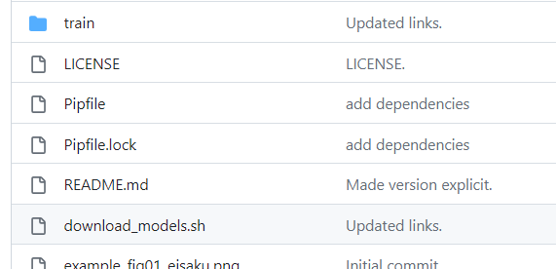
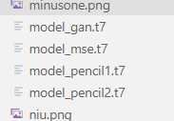
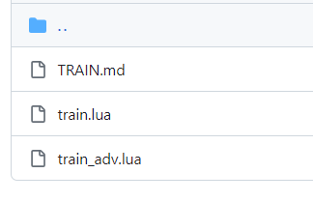
02-2 Main Reproduction results(1/10)
The author provided multiple models without full descriptions: there are “gan”,”pencil1/2” model but the original paper did not mention them at all.
And in these new models, “model_gan.t7” perform quite better.
So we only attempt to reproduct the original model “model_mse.t7”, and use others to generate groundtruth.
Notes:
使用说明：
1、这里是另一种文字页
2、文本框可自由填入内容，如文字过多，会自动缩排

Slide 19
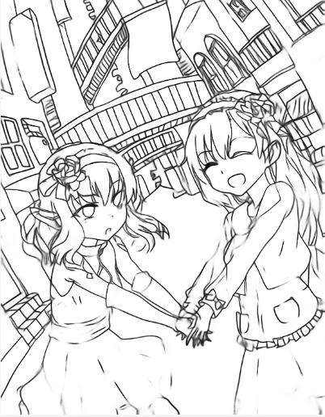
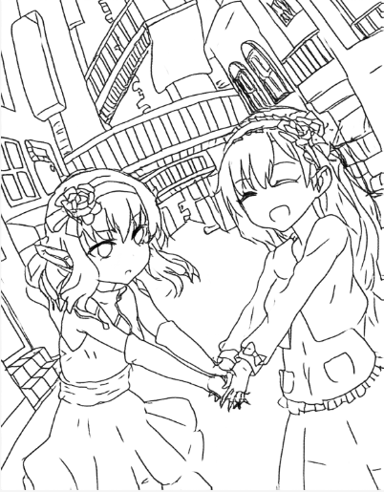
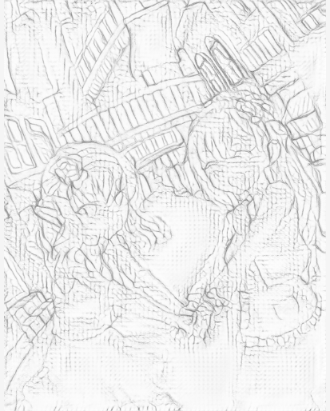
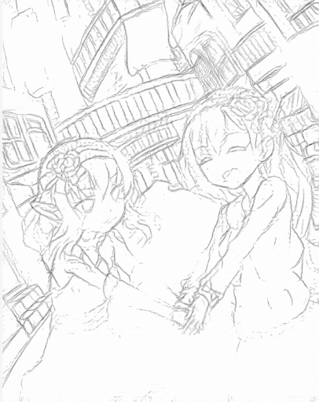
02-1 Main Reproduction results(2/10)
From left to right: mse, gan, pencil1, pencil2
Notes:
使用说明：
1、这里是另一种文字页
2、文本框可自由填入内容，如文字过多，会自动缩排

Slide 20
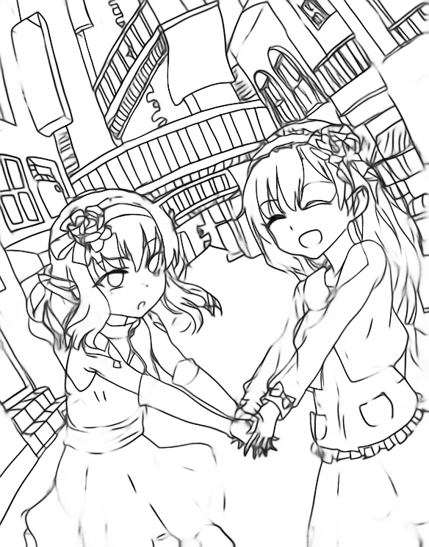
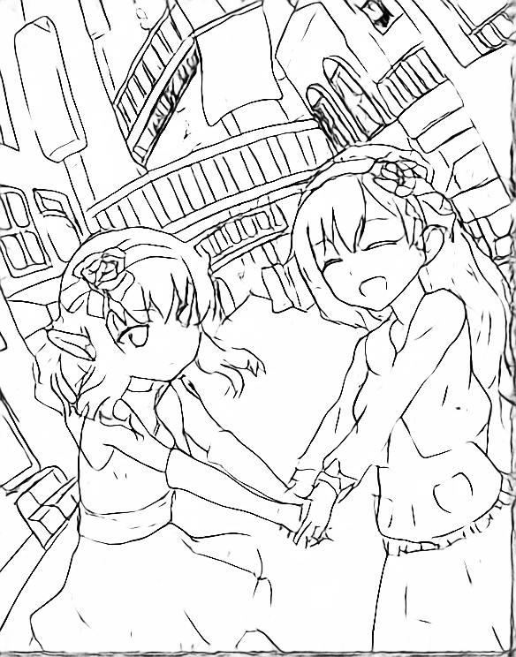
02-2 Main Reproduction results(3/10)
Author’s picture A
Source
Paper
Ours
Notes:
使用说明：
1、这里是另一种文字页
2、文本框可自由填入内容，如文字过多，会自动缩排

Slide 21
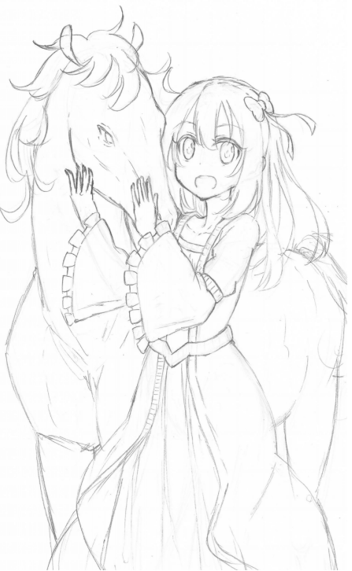
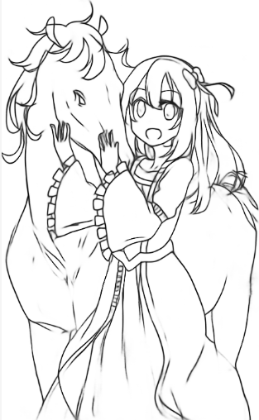
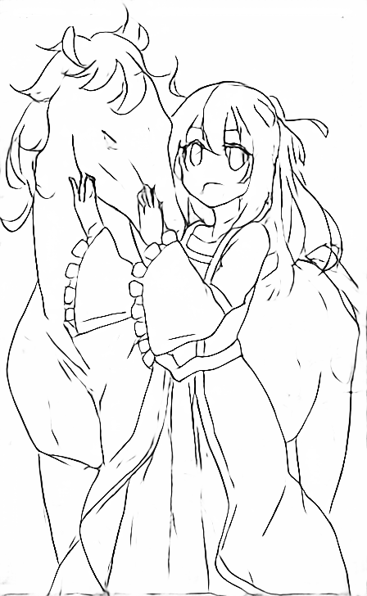
02-2 Main Reproduction results(4/10)
Author’s picture B
Source
Paper
Ours
Notes:
使用说明：
1、这里是另一种文字页
2、文本框可自由填入内容，如文字过多，会自动缩排

Slide 22



02-2 Main Reproduction results(5/10)
Author’s picture C
Source
Paper
Ours
Notes:
使用说明：
1、这里是另一种文字页
2、文本框可自由填入内容，如文字过多，会自动缩排

Slide 23
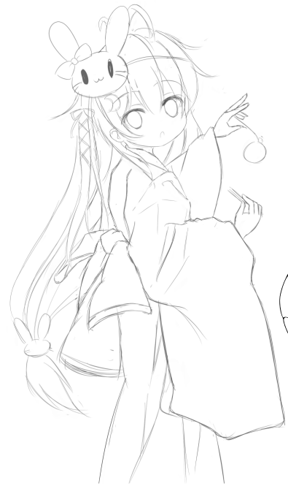
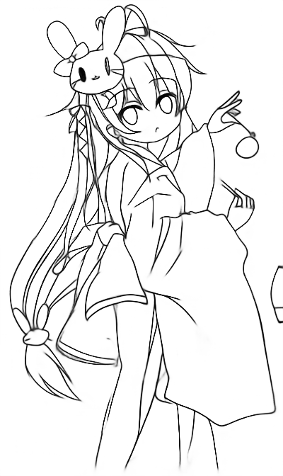
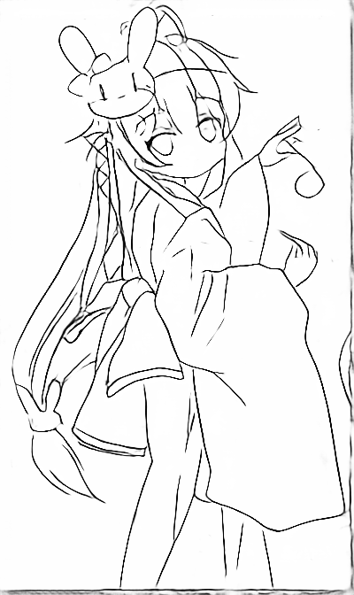
02-2 Main Reproduction results(6/10)
Author’s picture D
Source
Paper
Ours
Notes:
使用说明：
1、这里是另一种文字页
2、文本框可自由填入内容，如文字过多，会自动缩排

Slide 24
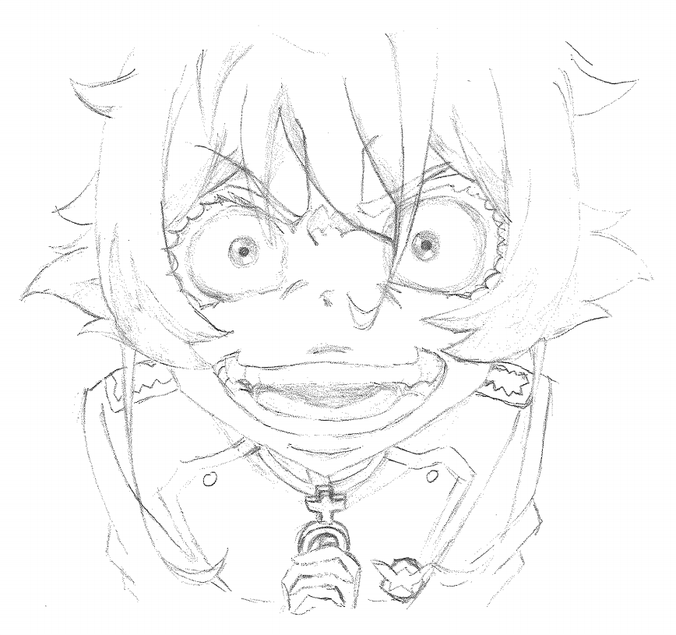
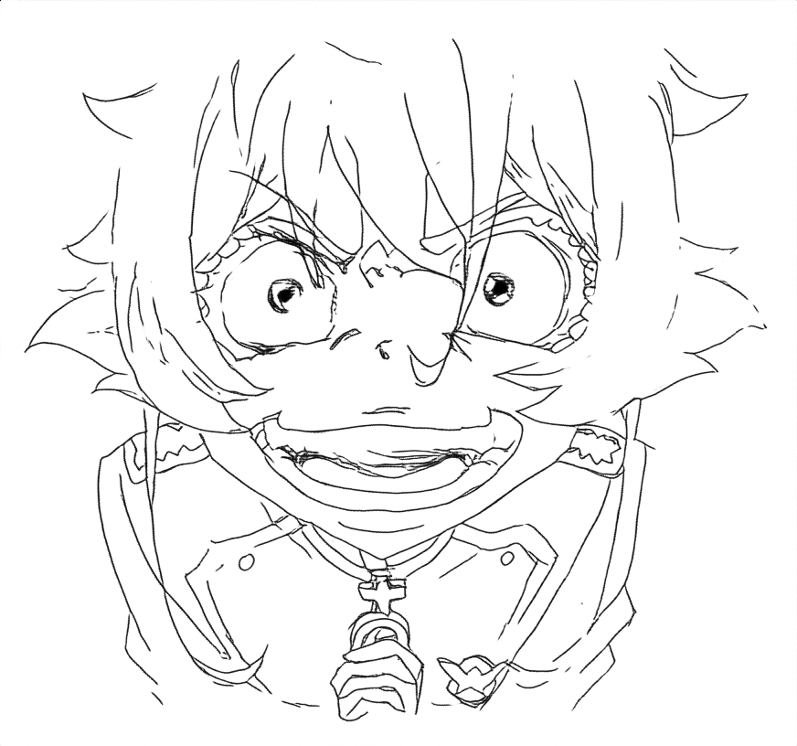
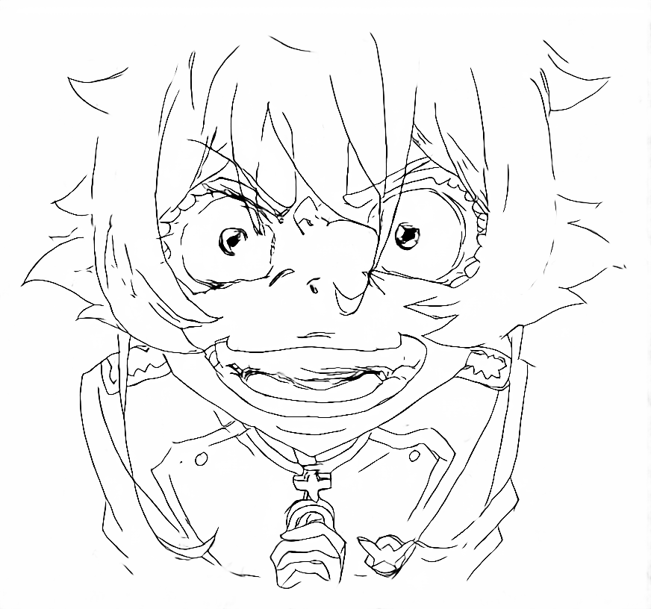
02-2 Main Reproduction results(7/10)
Our picture A
Source
Paper
Ours
Notes:
使用说明：
1、这里是另一种文字页
2、文本框可自由填入内容，如文字过多，会自动缩排

Slide 25
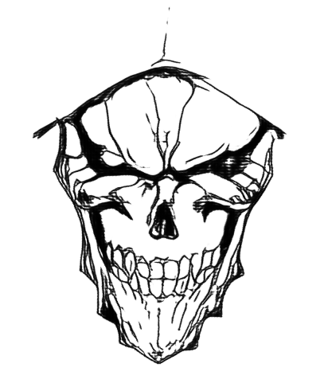
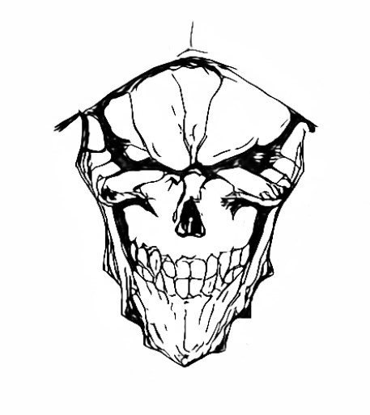
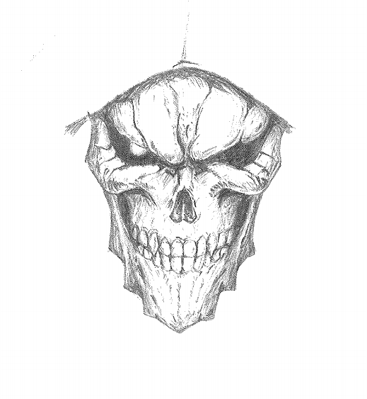
02-2 Main Reproduction results(8/10)
Our picture B
Source
Paper
Ours
Notes:
使用说明：
1、这里是另一种文字页
2、文本框可自由填入内容，如文字过多，会自动缩排

Slide 26
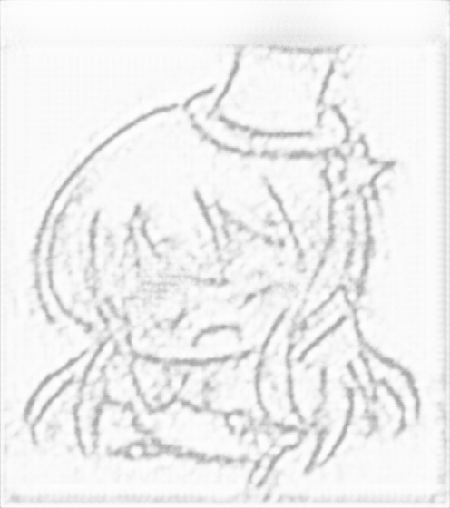
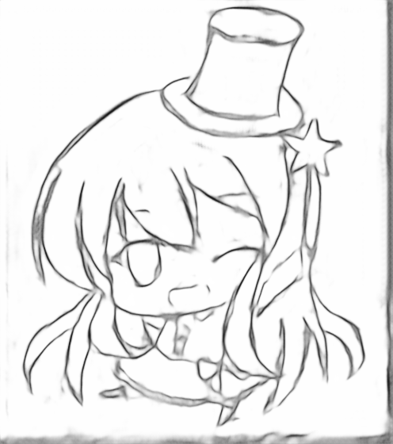
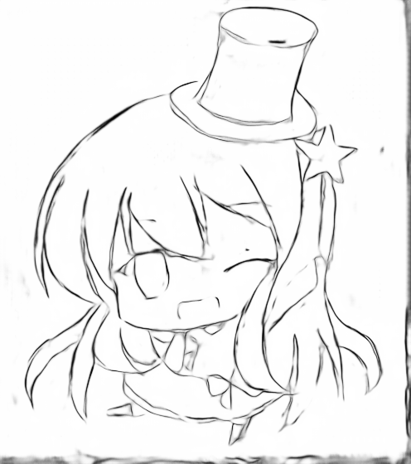
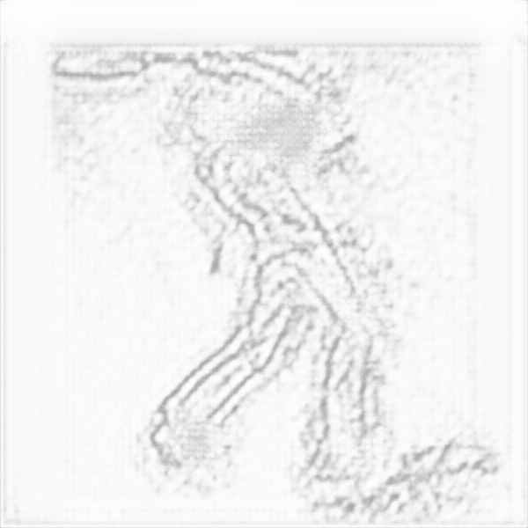
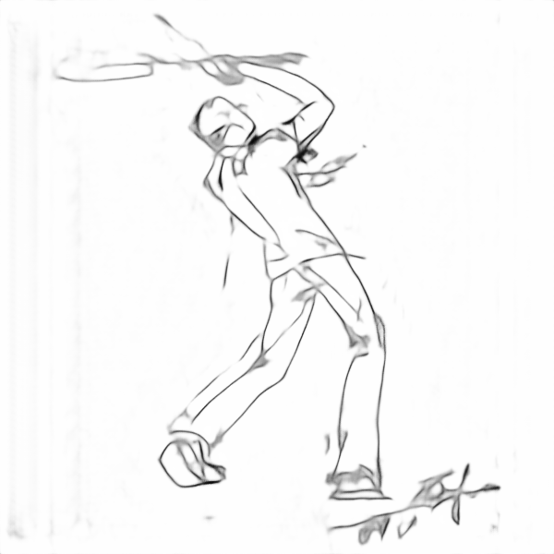
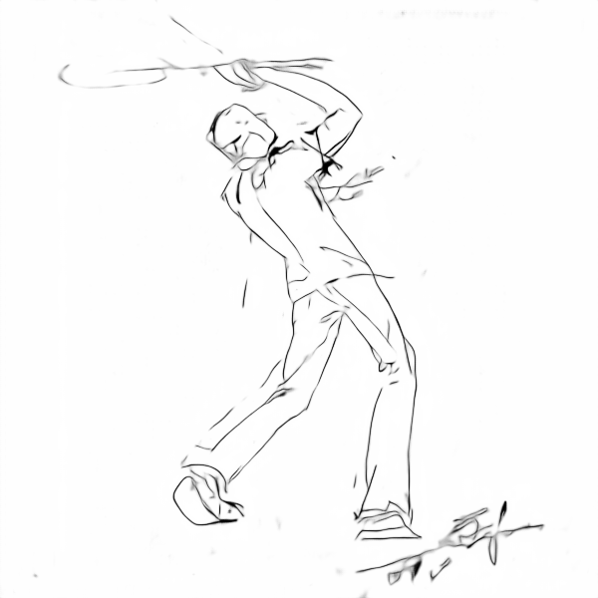
02-2 Main Reproduction results (9/10)
Change during iterations:
iter100 iter 2k iter 10k
iter100 iter 2k iter 10k
Source
Ours
Notes:
使用说明：
1、这里是另一种文字页
2、文本框可自由填入内容，如文字过多，会自动缩排

Slide 27
02-2 Main Reproduction results (10/10)
The effect after vectorizations:
Source
Ours-before
Ours-after
Notes:
使用说明：
1、这里是另一种文字页
2、文本框可自由填入内容，如文字过多，会自动缩排

Slide 28
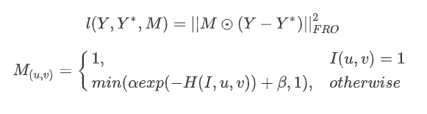

02-3 About the loss function(1/3)
The loss function author use is shown as follows:
Where H(I,u,v) is the value of the bin of the local normalized histogram in which the pixel I(u, v) falls into. The histogram is constructed using all pixels within Dh pixels from the center using Bh bins. The author set Dh=2, Bh=10.
By the code, we’ve learnt that H(I,u,v) actually equals to
Notes:
使用说明：
1、这里是另一种文字页
2、文本框可自由填入内容，如文字过多，会自动缩排

Slide 29
02-3 About the loss function(2/3)
For loops is too slow in python, but vectorize this formula is skillful.
Our solution is to calculate (2Dh+1)(2Dh+1) maps, all generated by a shift within the neighbor field, and calculate their contribution one by one with np.select().
We have tested the effect of this loss function by comparison.
Notes:
使用说明：
1、这里是另一种文字页
2、文本框可自由填入内容，如文字过多，会自动缩排

Slide 30






02-3 About the loss function(3/3)
Training with this single image by 50, 100, 200epoch from left to right.
Notes:
使用说明：
1、这里是另一种文字页
2、文本框可自由填入内容，如文字过多，会自动缩排

Slide 31

02-4 Dataset generation (1/9)
Several peculiarities the inverse dataset bears:
Small
Manual noise.
Low noise.
Random patches.
For 2, 3, 4, which are sensitive?

Slide 32


02-4 Dataset generation (2/9)
We’ve designed tests to validate the sensitivity of the dataset’s features.
The sources of our dataset:
ATD-12K. (left). Containing 12000 * 3 cartoon images from Disney & Kyoto anime.[Siyao et al, Deep Animation Video Interpolation in the Wild, CVPR2021]
Layout images from sakugabooru.com or baidu.com (mid)
3) Hand-drawn image by ourselves(right).

Slide 33



02-4 Dataset generation (3/9)
Since the author’s (mysterious) model is provided and has spectacular performance, it may provide layouts and our pencil-drawn image with the help of some extra binarizations.
For Example: left->author model -> global binarization with threshold=70->right

Slide 34




02-4 Dataset generation (4/9)
However the model is not designed to deal with colorful images.
Luckily, local binarization makes sense.

Slide 35




02-4 Dataset generation (5/9)
For noises, random noise(left-down) and tones(right-up) can be added by program automatically.
However slur (right-down)is hard to control, so we added it by PS.

Slide 36
02-4 Dataset generation (6/9)
Case ID | Original Image | Ground Truth
1 | 800 image from ATD-12K after local-binarization | The result after passing local-binarization, author’s model and global binarization in a row
2 | 73*4 image: 73 layout images and their 73*3 copies with 3 kinds of noises respectively | The result after passing the author’s model and global binarization in a row
3 | 73*2 image: original & slur | Same as above
4 | 73*2 image: original & random noise | Same as above
5 | Same as 2, but without random patches | Same as 2
1 vs 2: The importance of manual noise
3 vs 4: The importance of limited noise
2 vs 5: The importance of patches

Slide 37


02-4 Dataset generation (7/9)
Result of 1 vs 2: The importance of manual noise (epoch=300)
Regular cartoon image as test data may result in huge amounts of background noises. So it’s still not feasible to use common cartoon image as data to train this model today.

Slide 38

02-4 Dataset generation (8/9)
Result of 3 vs 4: The importance of limited noise (epoch=300)
Though generally similar, the result using high-slur has shallower color and shows plenty of grey piles & clusters in many arts of the images. If only use slur images as dataset, the result may get poorer. However in long run the result may become more similar. So the limited noise make some but not much sense.

Slide 39


02-4 Dataset generation (9/9)
Result of 2 vs 5: The importance of patches (epoch=100)
The benefit of using patches is generally get rid of large blank gaps. The result shows the patch may accelerate training to a great extent.

Slide 40
03
Analysis
The work we have done during reproductions.
Notes:
使用说明：
1、这里是1#转场页，图片为紫金港西区求是书院建筑群

Slide 41

03 Analysis (1/1)
We’ve generally reproduced the result of the original paper.
It’s a pity that we don’t have much time to create more detailing and fruitful dataset. Though the result is acceptable, various reasons including using “fake” groundtruth, short training time and the feature of dataset spark the inability to deal with dense lines and some details.
However the effect of the dataset & patch & limited noise are all shown clearly by the experiment.

Slide 42
04
Discussions
Some further discussions
Notes:
使用说明：
1、这里是1#转场页，图片为紫金港西区求是书院建筑群

Slide 43
04 Discussions (1/2)
As we’ve expected, though the loss map make some sense, the machine learning phase of the author’s method has lots of space for improvement (the existence of new models can prove this as well).
However the dataset construction seems to be tedious but pioneering. The comparison experiments have proven that both manual and low noise are important to spark splendid result. And as author have mentioned in the paper, the performance of the model greatly depend on the dataset.

Slide 44



04 Discussions (2/2)
Some future improvement path we’ve thought:
New machine-learning method based on lately models, e.g. SwinTransformer
Vectorization methods [Our blind field, attempted and failed]

